Slide 1

On Climate Variability And Resource-Dependent Wealth Dynamics:
The Case of Ethiopian Pastoralists
Paulo Santos
University of Sydney
Christopher B. Barrett
Cornell University
Presentation at Brookings Institution
Washington, DC
January 20, 2011

Slide 2
Motivation
Arid and semi-arid lands (ASAL) comprise ~ 2/3 of Africa, home to ~20 mn pastoralists - extensive livestock grazing.
Pastoralist systems adapted to climate regime, but vulnerable to drought. Rapid shift in climate could bring catastrophe.
Much attention to climate change impacts in Africa. But mainly on the likely effects of anticipated changes in average rainfall and temperature on crop output.
Little attention has been paid to the consequences of increased climate variability, nor to the likely effects on livestock systems, much less to the consequences of increased climate variability on livestock holdings.

Slide 3
Our Contribution
We explore the likely consequences of more frequent drought in the African ASAL on pastoralists’ livestock herd dynamics.
We use original primary data on rainfall-conditional herd growth dynamics collected among Boran pastoralists in southern Ethiopia to demonstrate state-dependence of herd growth and to reproduce unconditional herd dynamics observed in previous studies (Lybbert et al. 2004 EJ, Barrett et al. 2006 JDS).
We then simulate herd dynamics under changed climate distributions. The results demonstrate how vulnerable pastoralists systems are to relatively modest increases in the frequency of drought.

Slide 4
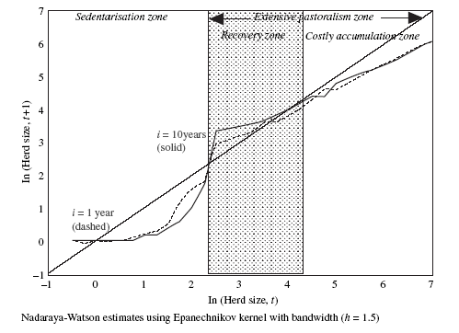
Previous results
Past herd dynamics studies from the region find nonlinear, bifurcated wealth dynamics. For example, among the southern Ethiopia Boran pastoralists we study, Lybbert et al. (2004 EJ) find:

Slide 5
Data and Methods
Data
Collected subjective herd growth expectations data, conditional on anticipated rainfall regime, from 116 households in four villages from same Boran region. Each household asked subjective dist’n of 1 year ahead herd size based on 4 randomly assigned initial herd sizes.
Methods
Nonparametrically explore differences in rainfall-conditional herd dynamics.
Fit parametric herd growth functions
Use estimation results from 2) and historical rainfall data to simulate decadal herd dynamics. Compare against previous results.
Use estimation results from 2) to simulate herd dynamics under different climate distributions.

Slide 6
Key findings 1
Key findings
Not surprisingly, herd dynamics differ markedly between good and poor rainfall states.
Figure 1. Expected one year ahead herd dynamics with (A) poor rainfall or (B) good rainfall. Points reflect herder-specific observations based on randomly assigned initial herd sizes. The solid line reflects stable herd size. The dashed line depicts the nonparametric kernel regression.

Slide 7
Key findings 2
Key findings
2) Simulated herd dynamics using parametric herd growth function estimates and historical (N(490, 152)) rainfall distribution generates unconditional herd dynamics very similar to observed patterns. So pastoralists seem to grasp clearly the underlying herd dynamics of he current system.

Slide 8
Key findings 3
Key findings
3) Herd dynamics change with drought (rainfall <250 mm/year) risk. Halving the current risk would enhance resilience and eliminate apparent poverty trap. By contrast, doubling drought risk would eliminate high-level equilibiurm and lead to system collapse in expectation.
Simulated using the parametric herd growth function estimates and mean-preserving changes of rainfall variance, defined by π= prob(rainfall<250 mm/yr)

Slide 9
Policy implications
The main store of wealth of Africa’s pastoralists is at risk if climate change brings increased drought, as expected.
Climate variability adaptation is crucial
ASAL pastoral systems highly vulnerable to potential system change due to quite plausible changes in rainfall variability. Need more than just food aid in response to disasters. Must begin addressing:
-range and water management
-resource tenure (e.g., dry season reserve access) and reconciliation with biodiversity conservation goals
- livestock insurance

Slide 10
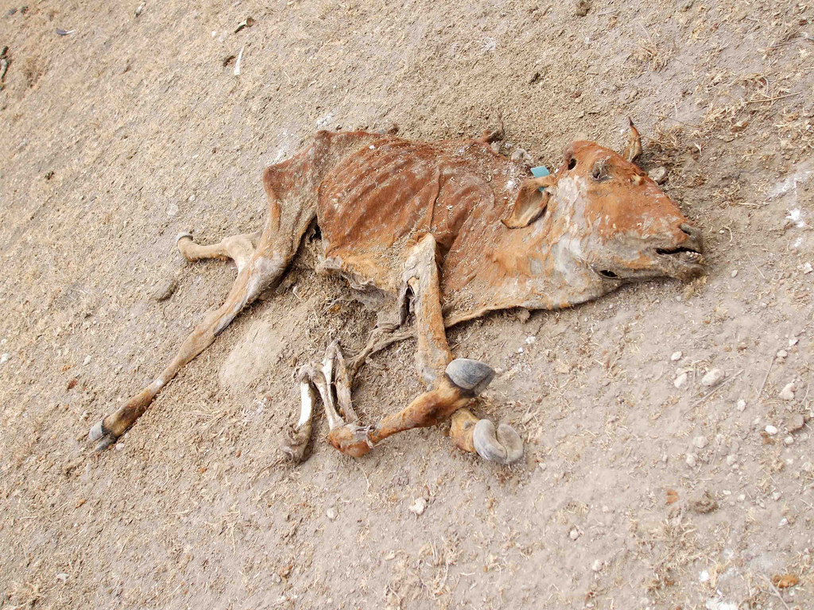
Thank you for your time,
interest and comments!

Slide 11
Backup table
Parametric herd growth estimates match NP results
Table 1. Estimates of expected one year ahead herd size conditional on rainfall regime (columns) and randomly assigned initial herd size (h0). P-values in parentheses; estimates statistically significant at the five percent level in bold.

